Slide 1
PYTHON PROGRAMMING
MODULE 4

Slide 2
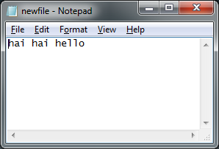
Let say we have text file…

Slide 3
So, how to get the words from the text file in Python ?
In this session, I’ll show you how external text file can be an input~~

Slide 4

Read from external textfile
1st step: write a code to open text file.

Slide 5
Read from external textfile
2nd step:
Assign a variable to read line in textfile

Slide 6
Read from external textfile
3rd step:
Print the variable that read the line

Slide 7
Read from external textfile
Last step:
Close the file

Slide 8
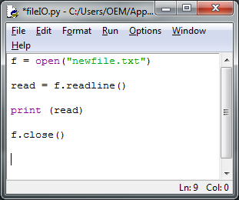
Full Code

Slide 9
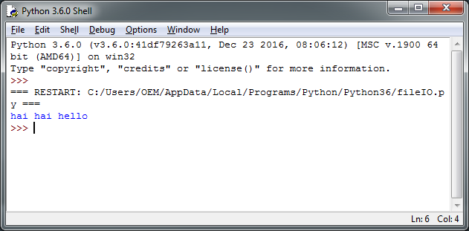
Output

Slide 10
So, what if we want to WRITE a text file from Python?
In this session, I’ll show you how to generate a textfile from Python

Slide 11
Writing a textfile
1st step: write a code to open text file. (note: this method is different from reading text file!)

Slide 12

Writing a textfile
2nd step: write code to “write” that will be appear in the text file

Slide 13

Read from external textfile
Last step:
Close the file

Slide 14
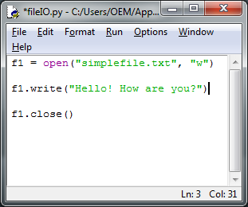
Full Code

Slide 15
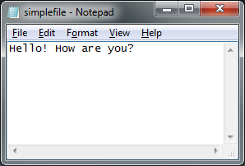
The textfile generated…

Slide 16
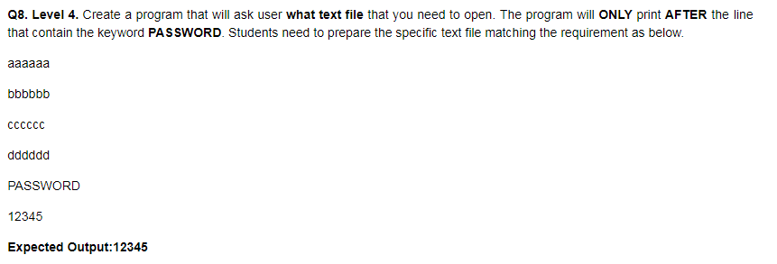
Exercise

Slide 17
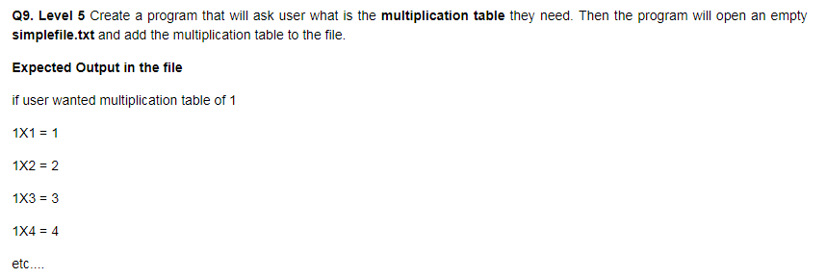
Exercise

